Slide 1
CitacePRO
Add-on installation manual for MS Word, MS Word 365, Mozilla Firefox, Chrome and MS Edge
PhDr. Jan Emmer
October 2023

Slide 2

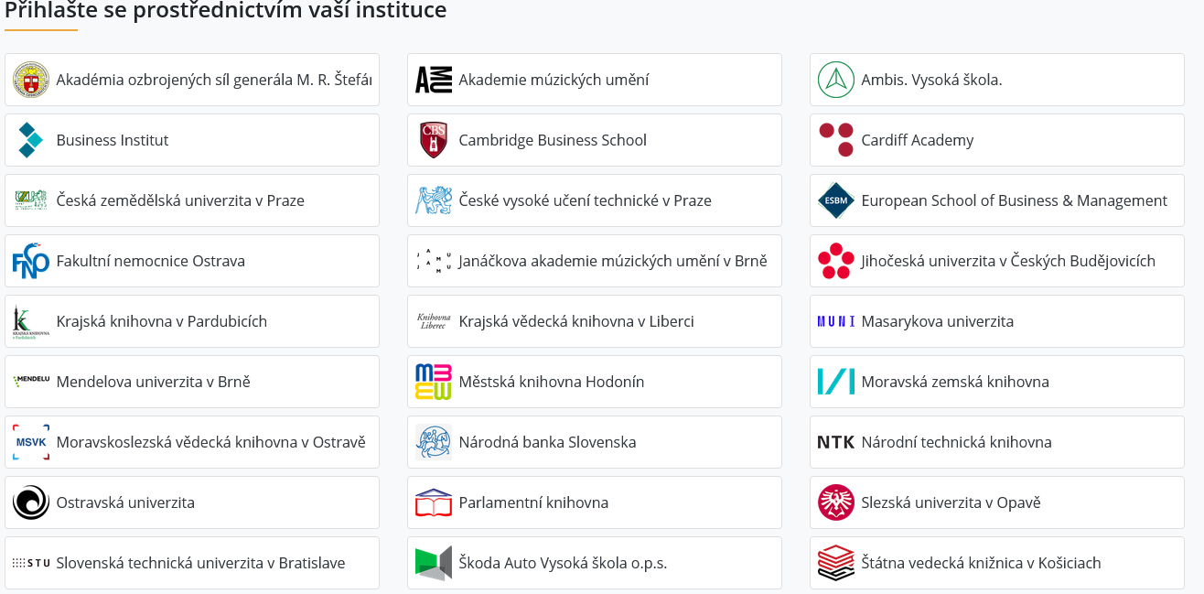
CitacePRO Service login - 1
Sign up for the service at www.citace.com or www.citacepro.com.
Select Škoda Auto Vysoká škola from the list of schools.

Slide 3
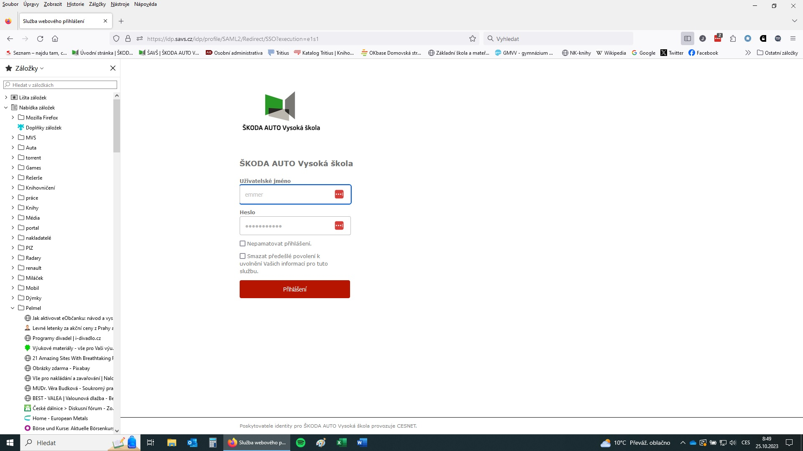
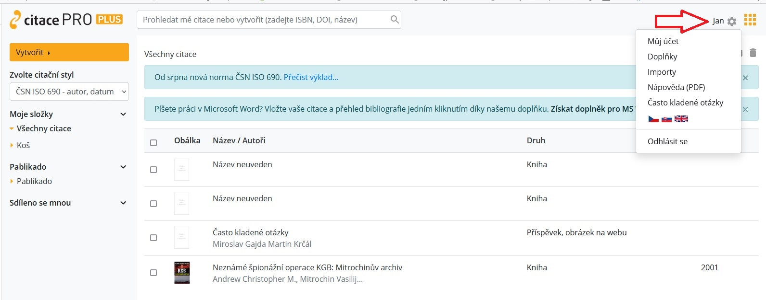
CitacePRO Service login - 2
For authentication, enter the school login data (just like, for example, for entering ProQuest databases, etc.)
If we are logged in correctly, we can see our name.
After logging in, we can work with the citation manager, for example, according to this guide: https://vimeo.com/656620745.

Slide 4
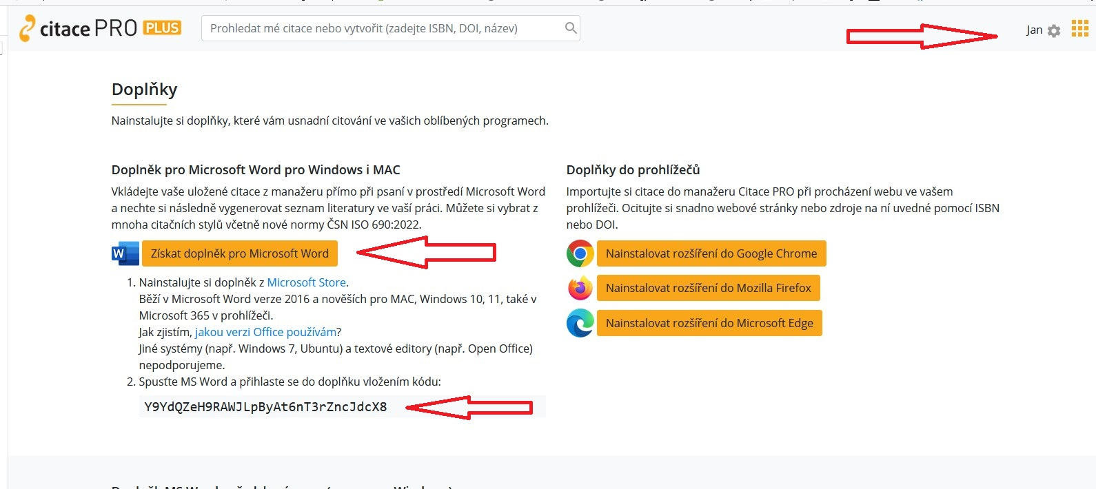
Installing an add-on for MS Word - 1
Expand the "gear" in the right corner, select Add-ons.
Choose "Get an add-on for MS Word, at the same time copy the code at the bottom of the page to the clipboard.

Slide 5
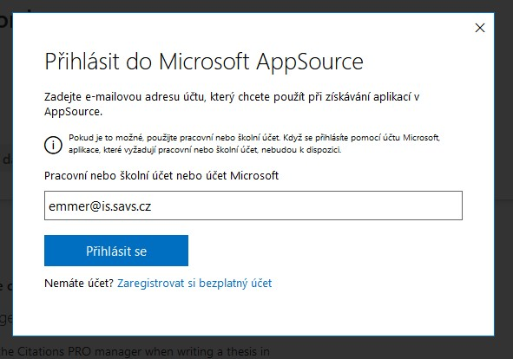
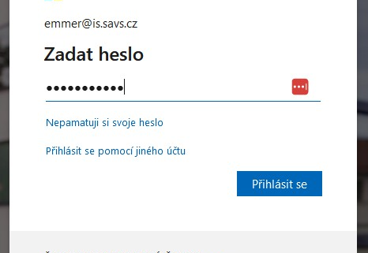
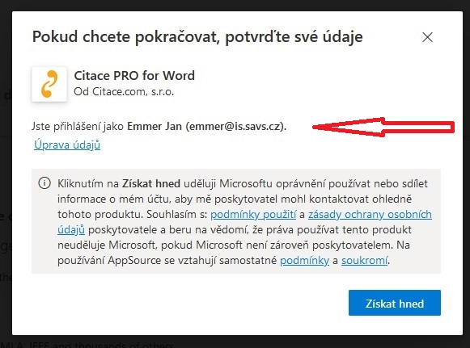
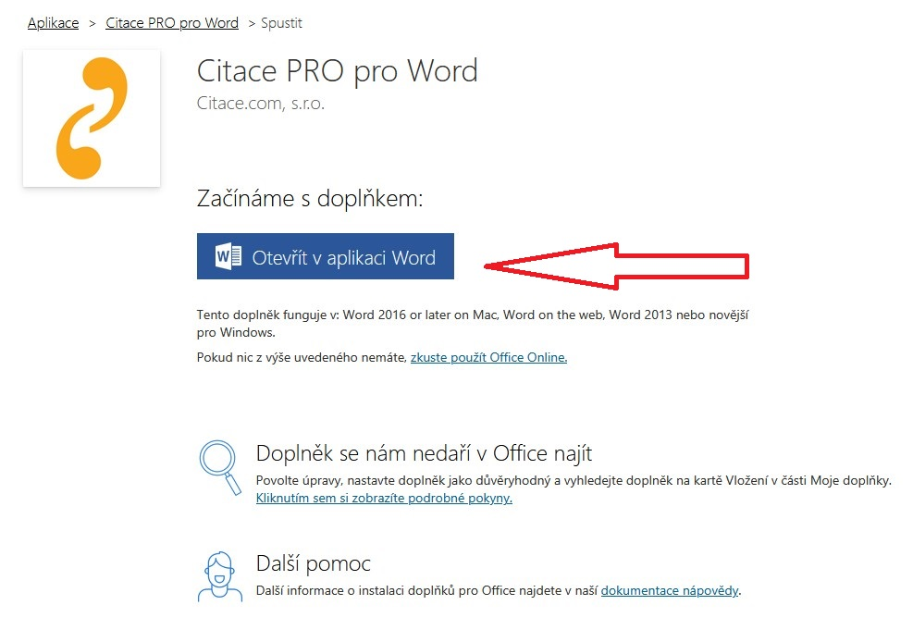
Installing an add-on for MS Word - 2
Log in to MS AppSource with the school email in the format @is.savs.cz.
Fill in the school password.
You can see the correct login in the next step.
Open the add-on in MS Word.

Slide 6
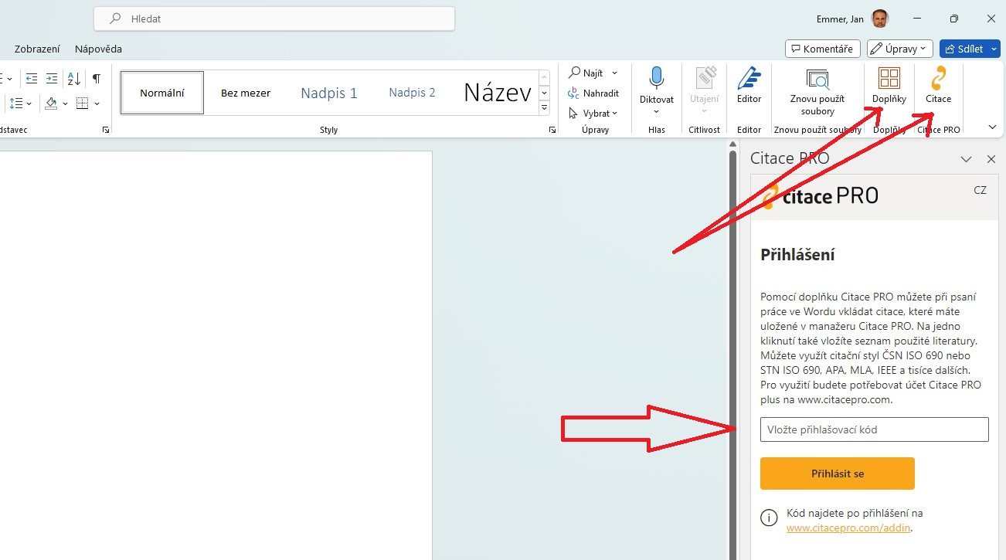
Running the add-on in MS Word
The "CitationPRO" icon should appear on the toolbar in MS Word, or you can add it from Add-ons under the red window icon.
You have to enter the activation code.

Slide 7
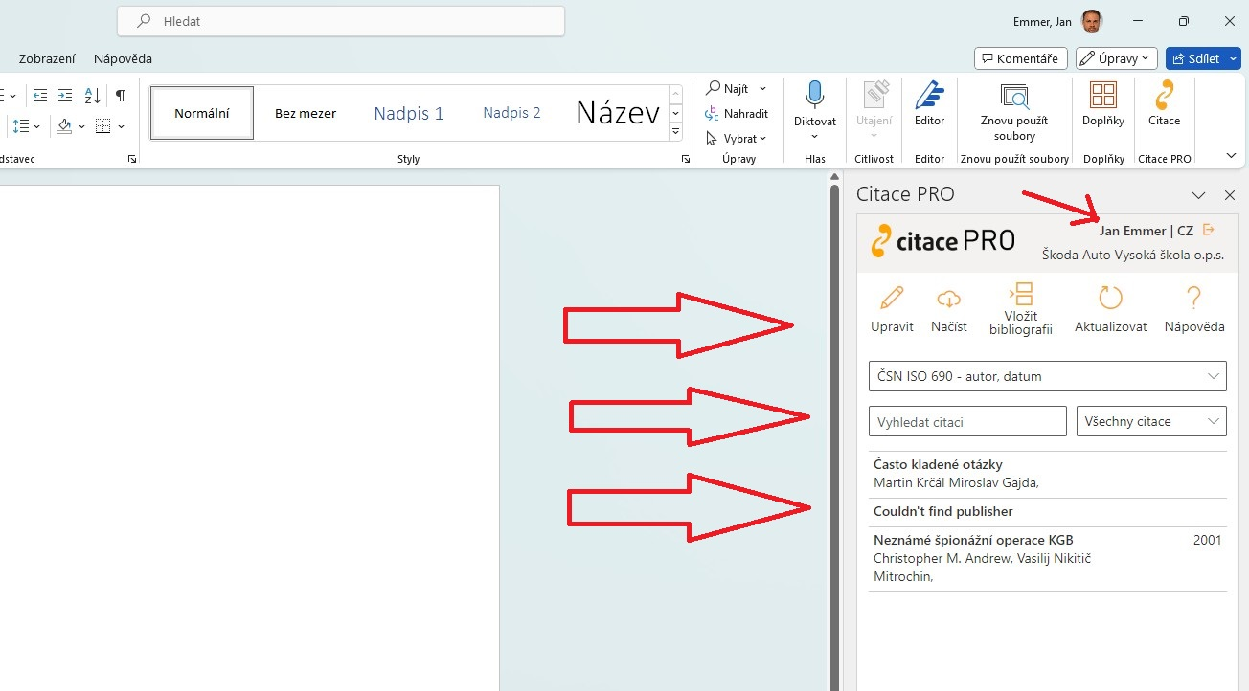
Working with add-on in MS Word
In the right corner, you can see that you are logged in to your CitacePRO account
You can see your citations loaded, you can search them, insert them, edit them, change citation styles, insert a bibliography...
I recommend trying it, it's very intuitive ☺.

Slide 8
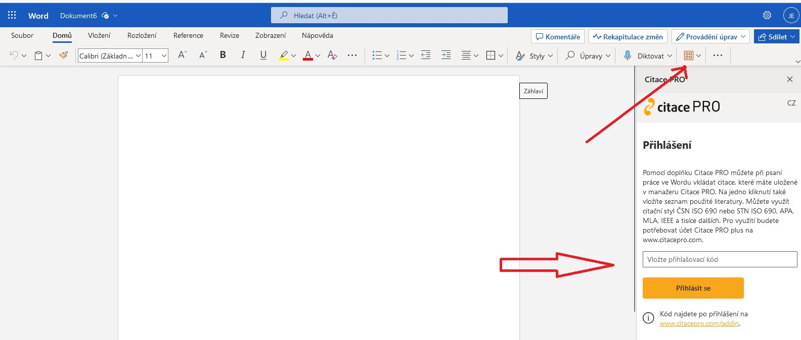
Add-on activation in MS Office 365 Word
Analogously, you have to activate the add-on by entering the code MS Office 365 Word.

Slide 9
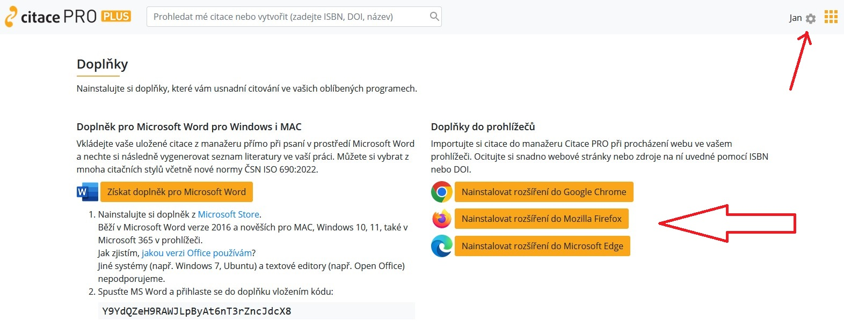
Activating a browser add-on (using Mozilla Firefox as an example) - 1
You can find the add-on for the browser again under "gear" in the Add-ons section.
Choose one of the supported browsers.

Slide 10
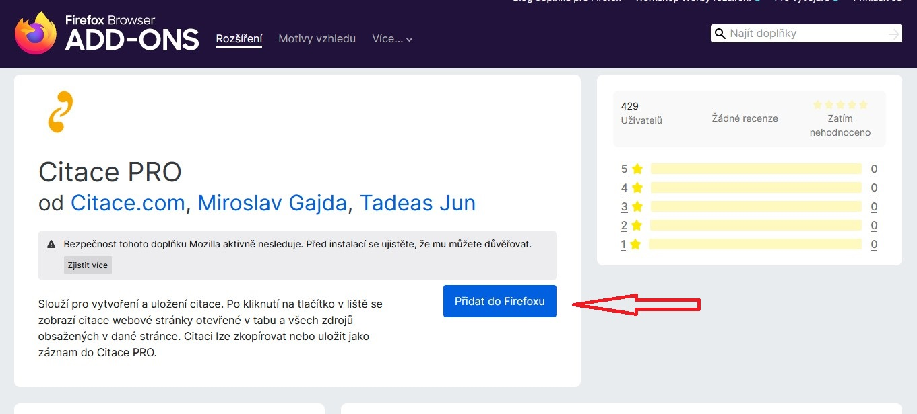
Activating a browser add-on - 2
Next, proceed according to the instructions of the given browser, agree to the rights, or go through the add-on settings - all depending on the browser.

Slide 11
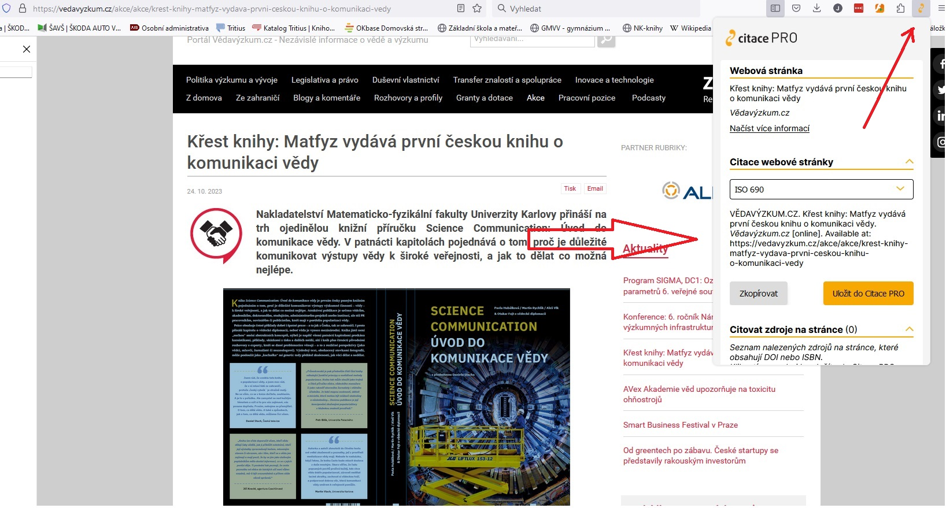
Working with the add-on in the browser - 1
The add-on informs you about the given page and creates a citation for it according to the chosen citation style.
You can then transfer this citation to your account in CitacePRO, where you have to check it and, if necessary, expand or correct it!

Slide 12
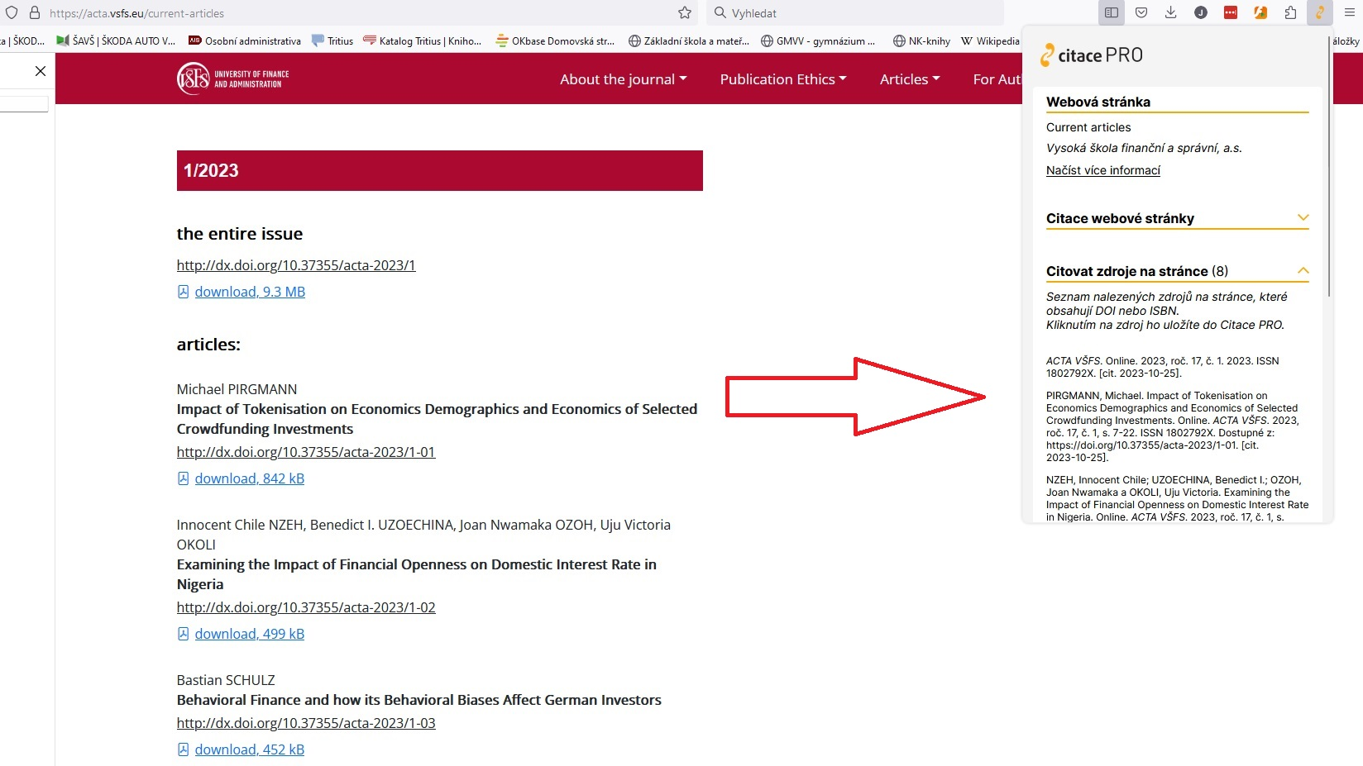
Working with the add-on in the browser - 2
If the add-on captures an ISBN in a reasonable format or DOI on the page, it immediately creates citations, which you can transfer to your CitacePRO account by clicking on it.
However, you have to check it again and, if necessary, expand or correct it!

